Slide 1
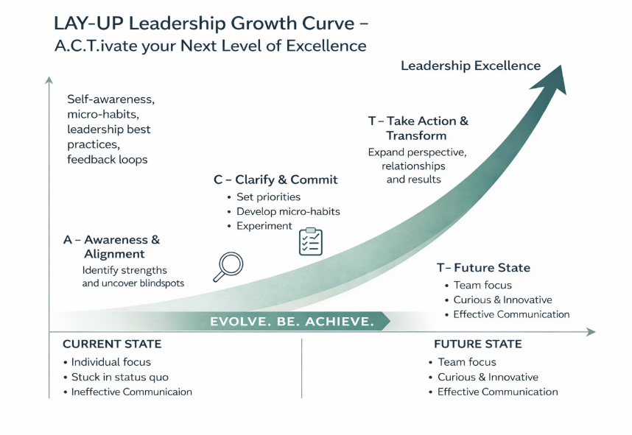


LAY-Up Leadership Development Approach
Why ACTIVATE™ Works:
Grounded in neuroscience and adult learning theory, this framework builds the mindset, habits, and skills leaders need to thrive in complex, changing environments—developing sustainable behavior change
**Current State & Future State are for illustrative purposes only – as the current state conditions & future state aspirations of each leader will be unique

